Slide 1

Medical Store-Distributor-Consumer Network
Design and 30% Presentation Template
Abdulla Iqbal FA17-BSE-030
Armaghan Hassan FA17-BSE-045
Majid Durani FA17-BSE-021
Supervisor: Sir Kashif Nasir
Department of Computer Science
COMSATS University Islamabad, Abbottabad Campus

Slide 2
Agenda of the Presentation
Agenda of the presentation is to study the following:
Software Requirement Document
Software Design Document

Slide 3
Brief Introduction

Slide 4
Scope
Our system will target Medicine market.
The problem with current medicine market is that all the communication, transactions, order placing, and order delivery is based on paperwork and wire transfers which results in delays and no monitoring.
Our system will provide online platform for both Medical Stores and Pharmaceutical Companies.
It will allow them to monitor transaction, order details, order delivery status, point of sale details, inventory managements.
Physical Order Delivery will not be covered by this system.

Slide 5
Functional Requirements
A new user would be able to get register by proving the required credentials.
User cannot login until Admin verifies them(Payment, License).
User shall be able to select the desired package.
User can register multiple times but Email, License No Must be different.
User shall be able to login, will use Email and password to login.
Retailer should be able to buy the medicines from the Distributor online and he can also pay for that order by credit card or payment on delivery.
Retailer shall be able to use the point of sale to sell their product to the Customer.
User should be notified if the product is about to get out of stock.
User should be able to mention their inventory by adding, deleting and updating the items.
User should be able to manually update the stock in the inventory.
When Distributer add the product in the inventory it should automatically be available to the Retailer at the online market.
User should be able to generate reports based on Daily, Monthly and Yearly.
User should be able to see their transection detail
User Should be able to only change the address, email, password, contact and credit card details
Physical delivery of medicine is not goanna be a part of the system.

Slide 6
Non-Functional Requirements
User shoulder be able to learn how to operate the website with in 30 min of training.
Down time of the website should not exceed more than 10 sec for continuous succession of 500 hrs.
Website should be able to handle 100 hits per minute.
Website should be able to work on any browser.
User should be notified if the product less than 7.
The system development process and deliverable documents shall conform to the ISO 45001 (Health and Safety Management Standards)
The system shall not disclose any personal information about members of the MSDCN to other members except system administrators.
Cerdit Card details should be stored in an encrypted form.
Medicine Retailer price and Distributor price should be set by themselves.
Our company is complied with the local and national laws regarding the use of software tools.

Slide 7
User Goals
Identify the goals of your system

Slide 8
Use Cases

Slide 9
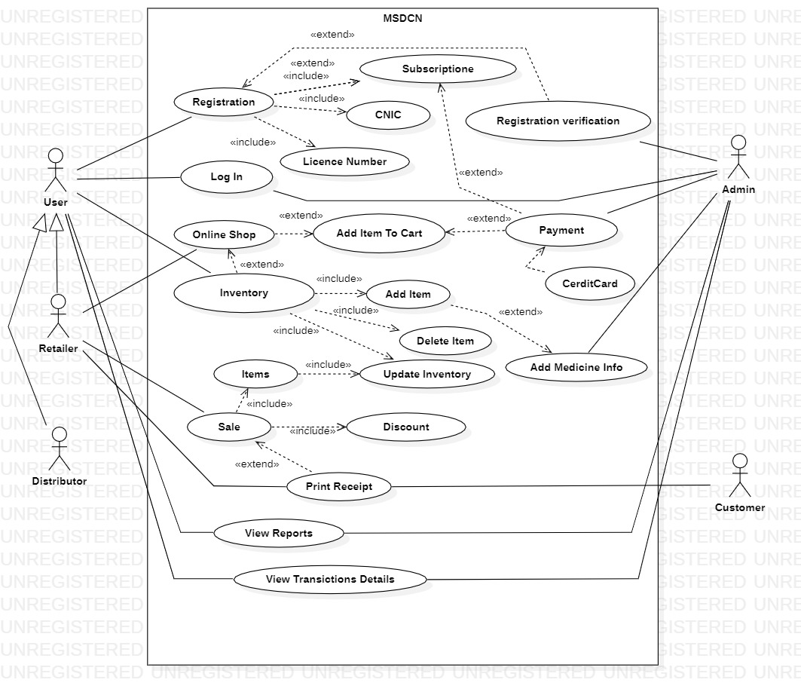
Use Case Diagram

Slide 10
Class Diagram

Slide 11
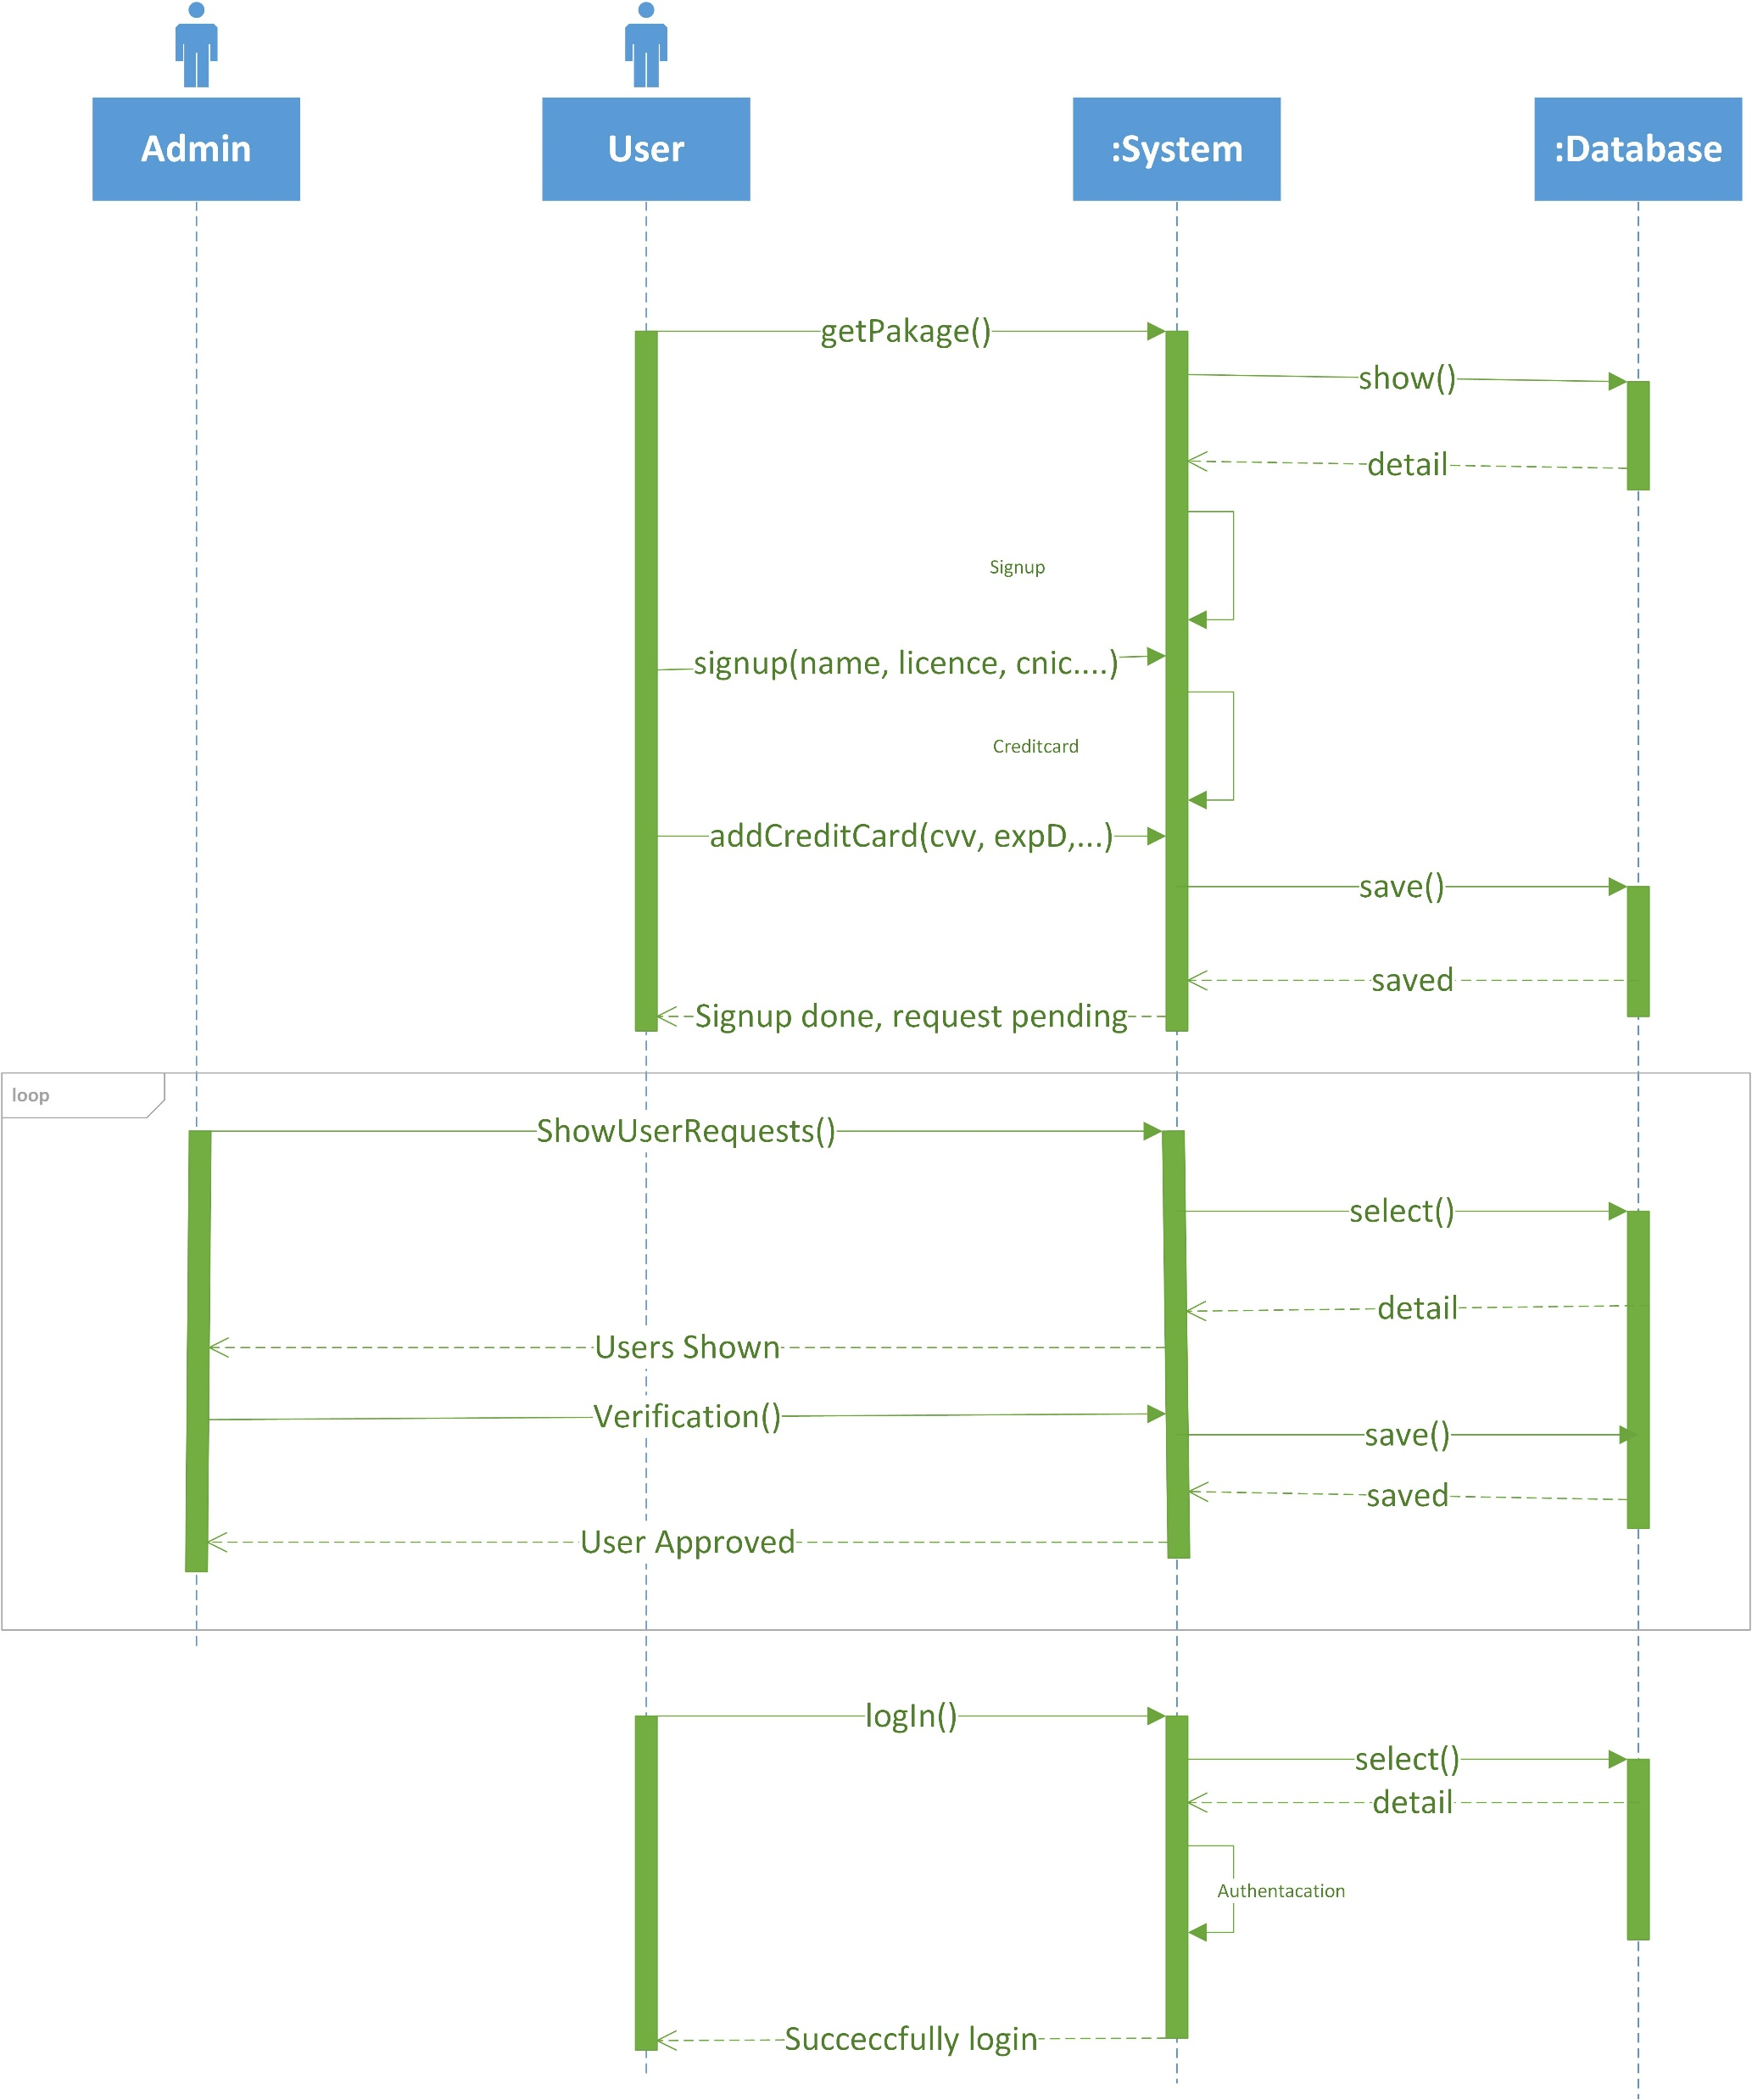
Sequence Diagram

Slide 12
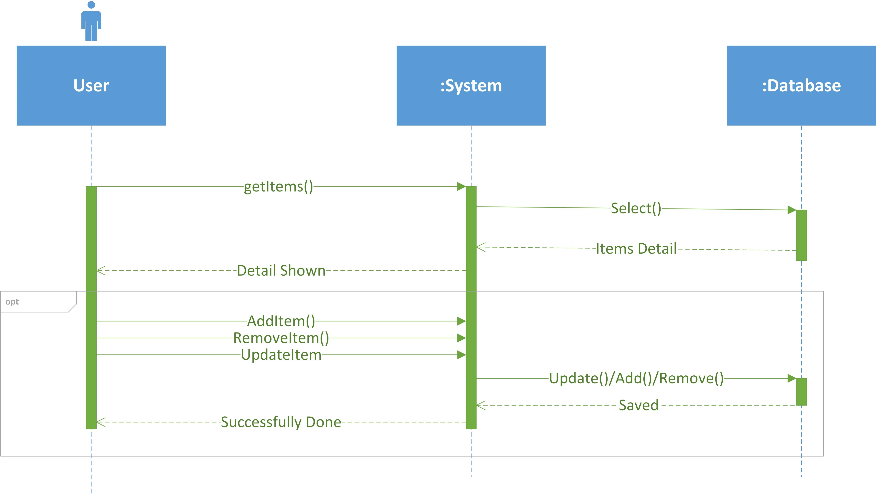
Sequence Diagram

Slide 13
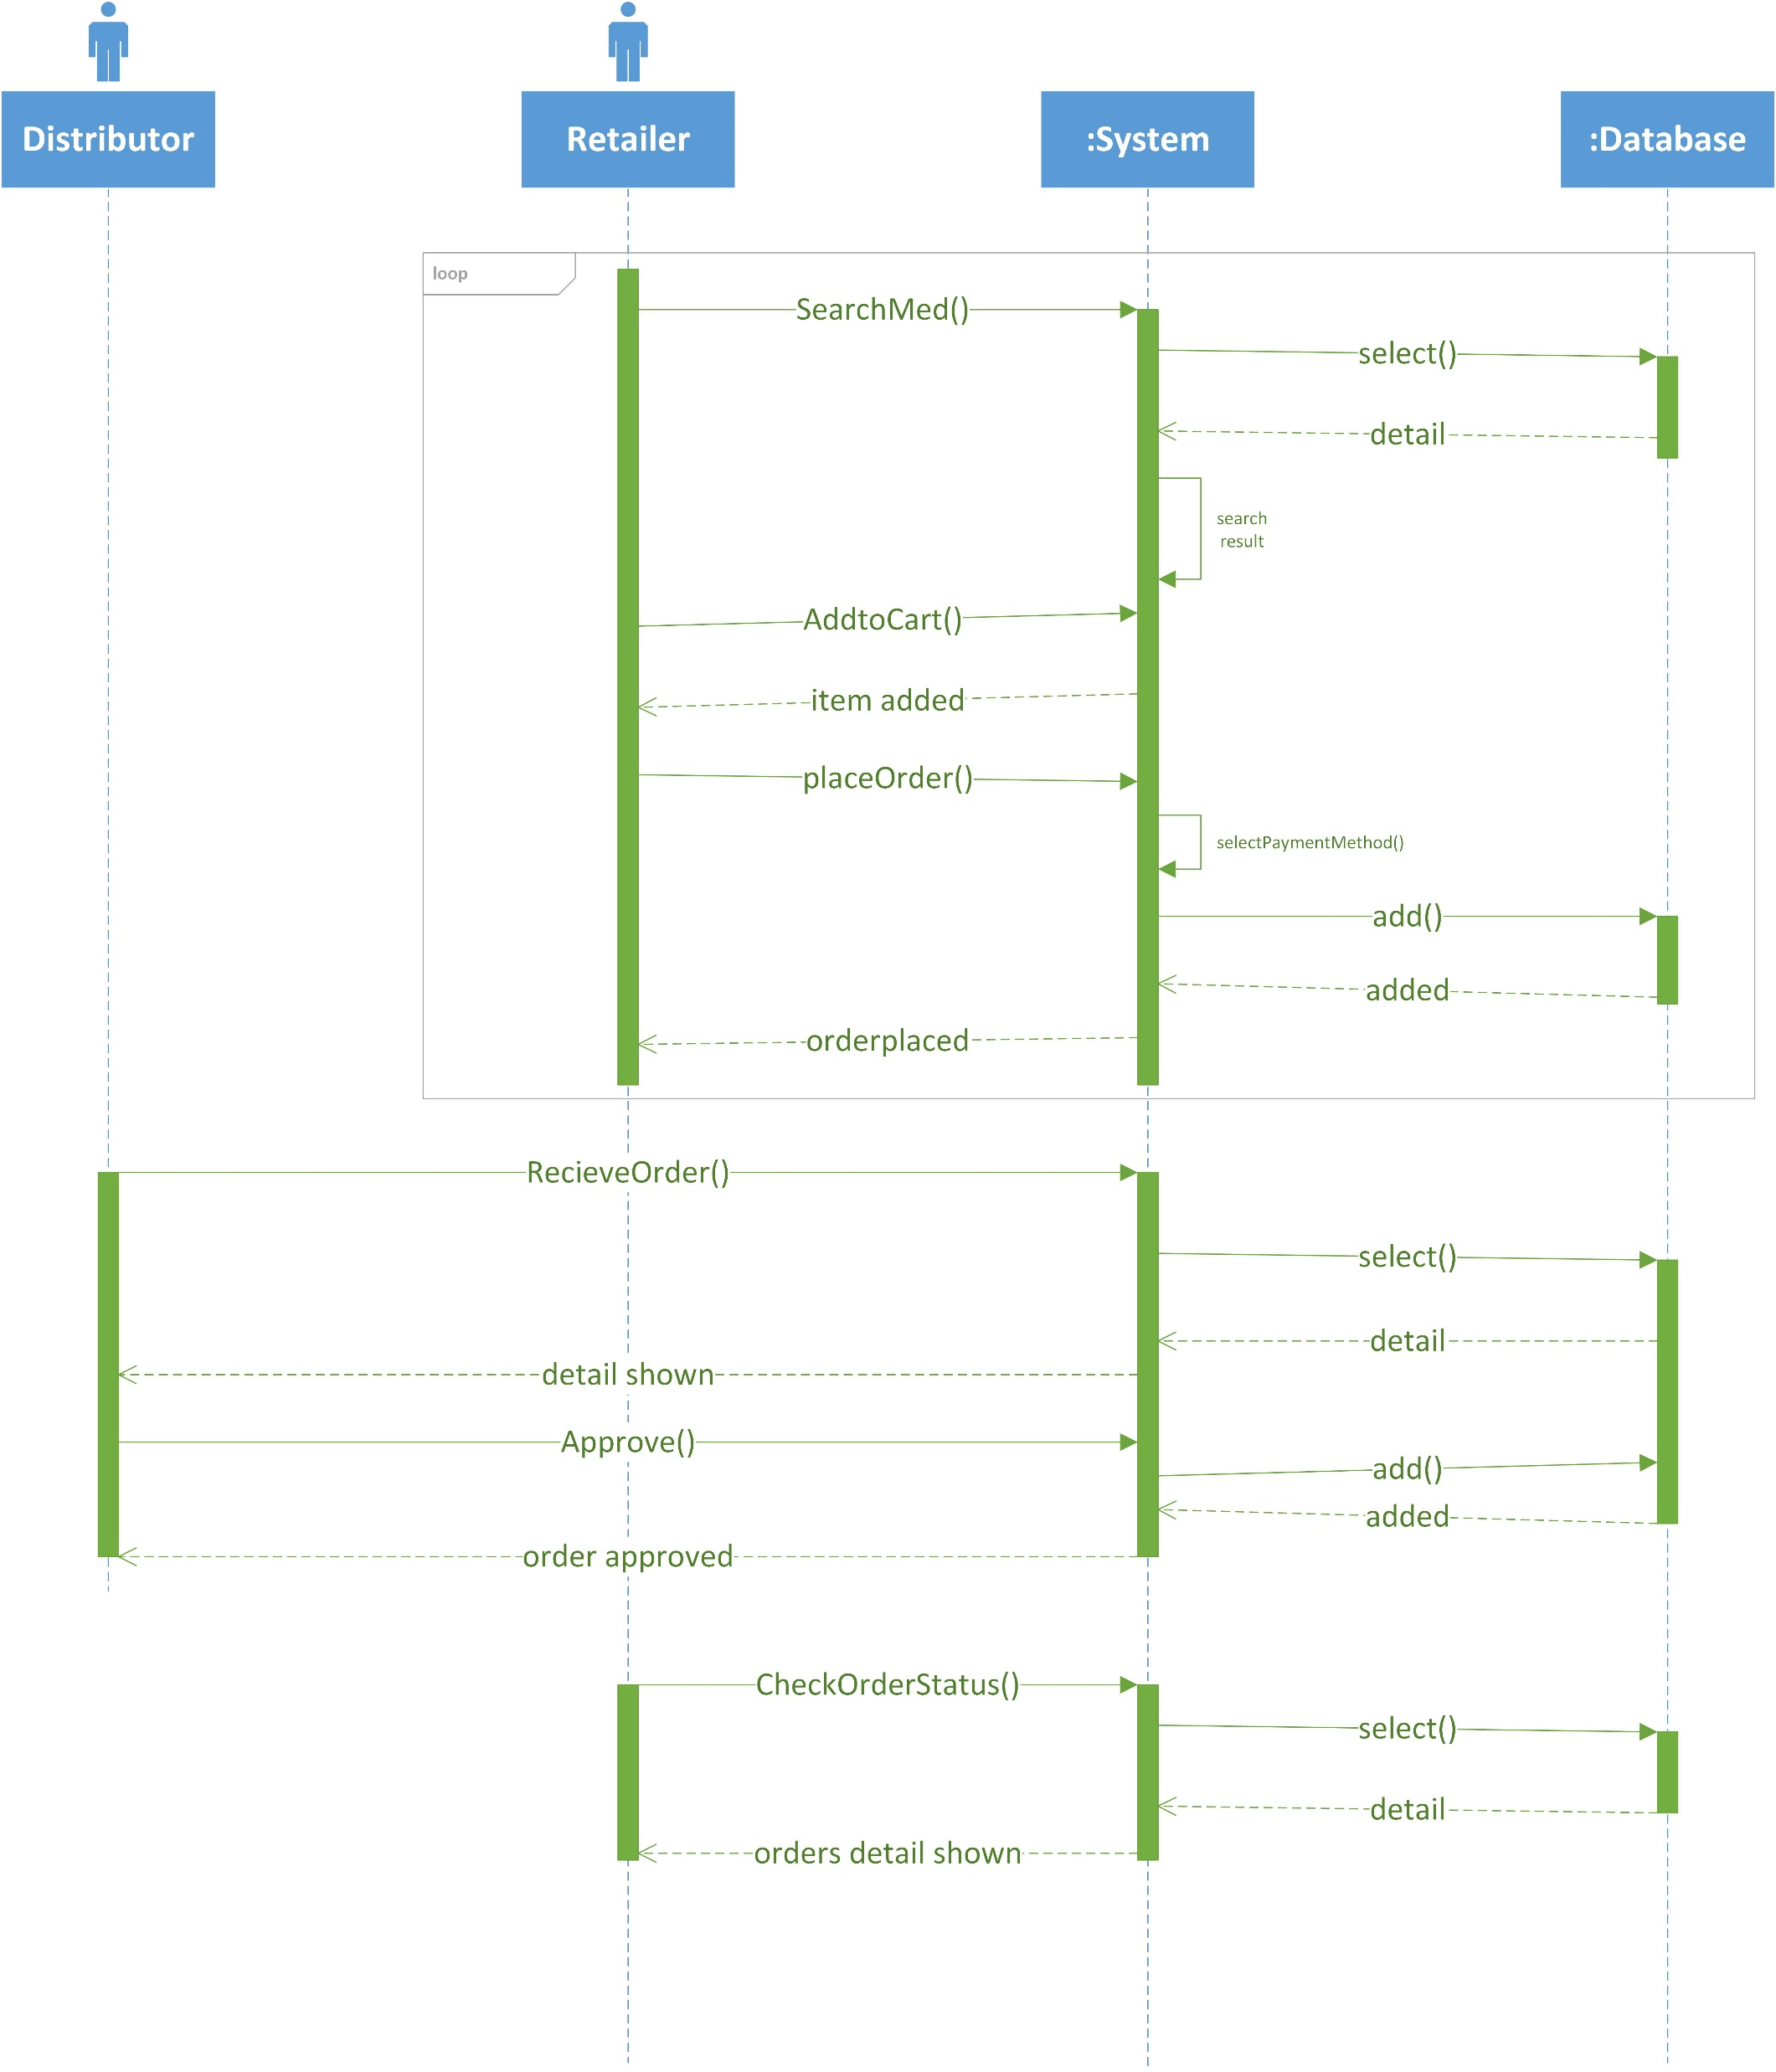
Sequence Diagram

Slide 14
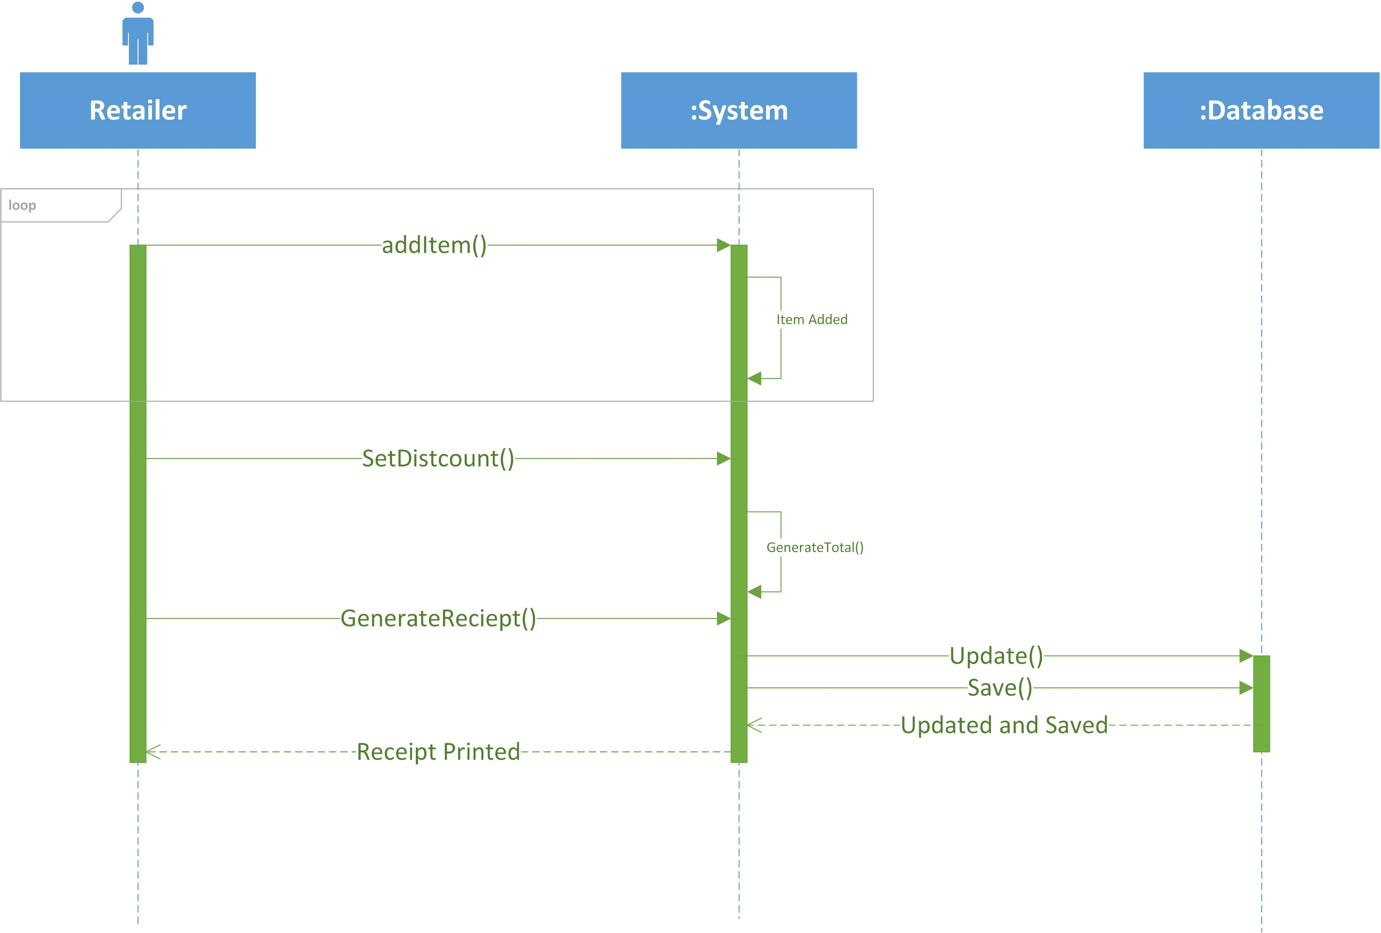
Sequence Diagram

Slide 15
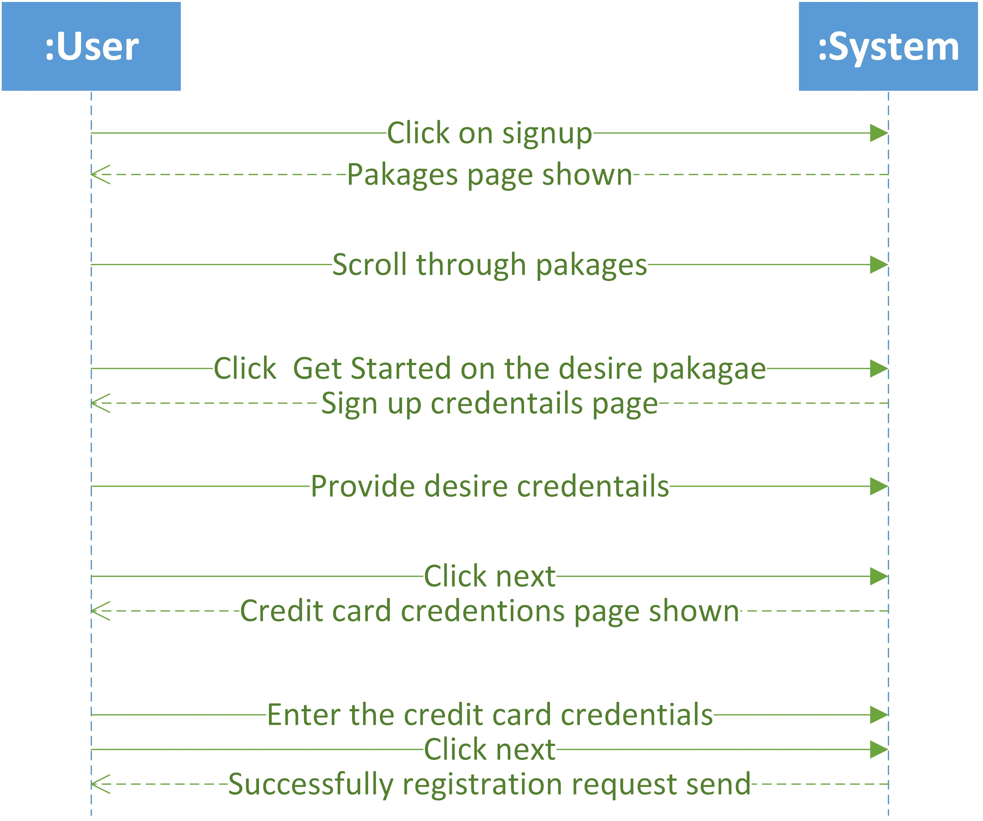
System Sequence Diagram

Slide 16
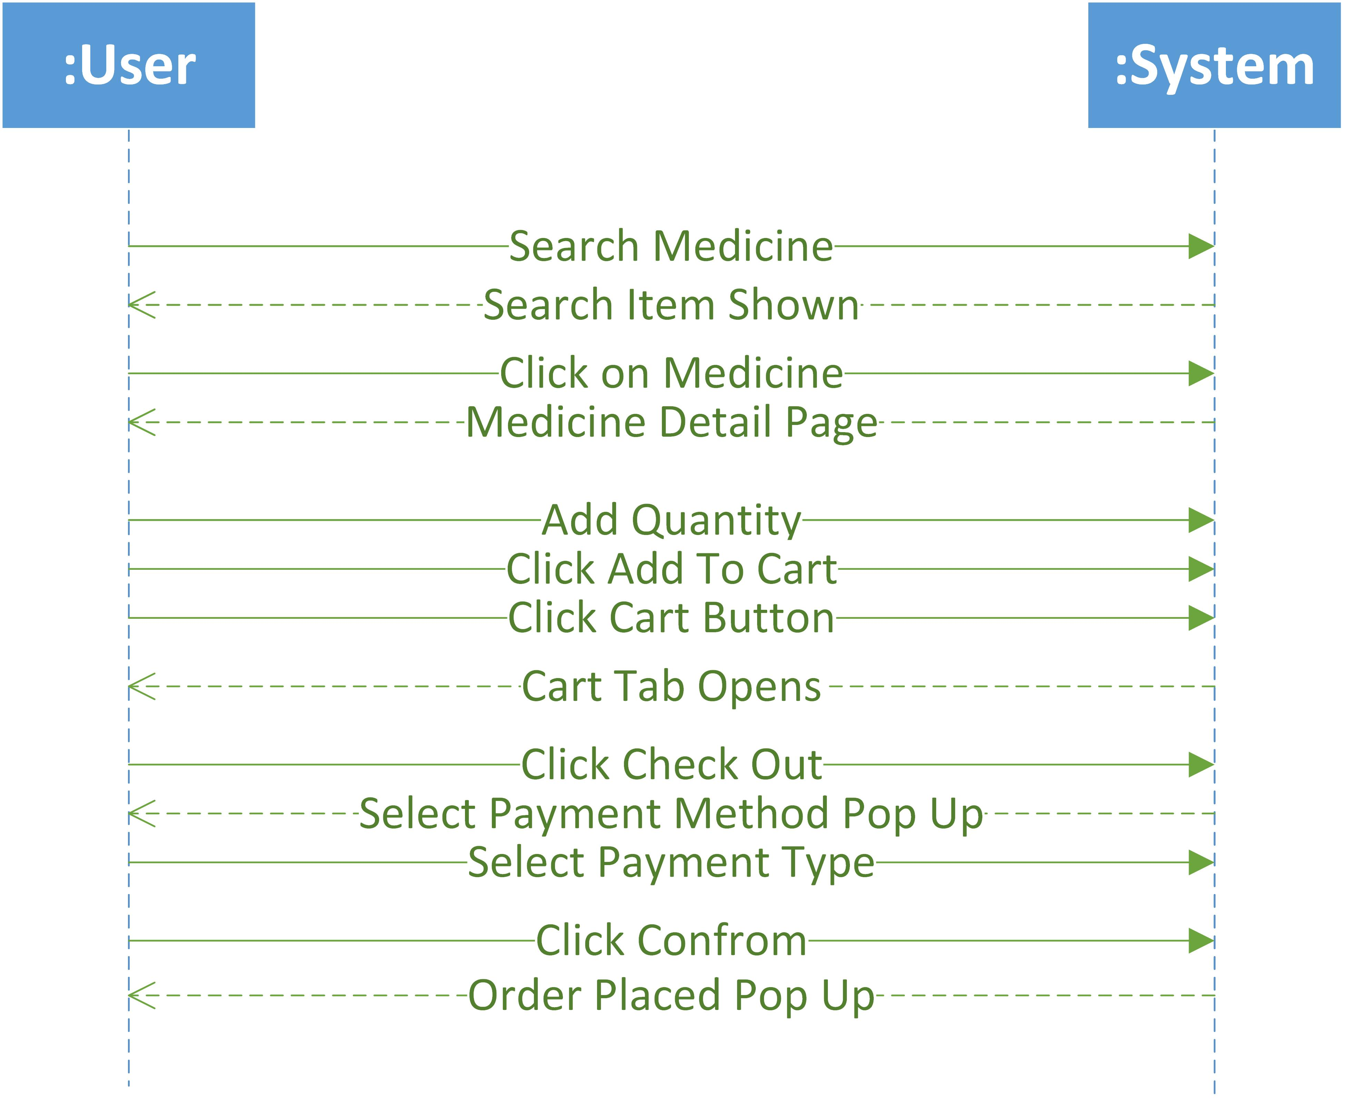
System Sequence Diagram

Slide 17
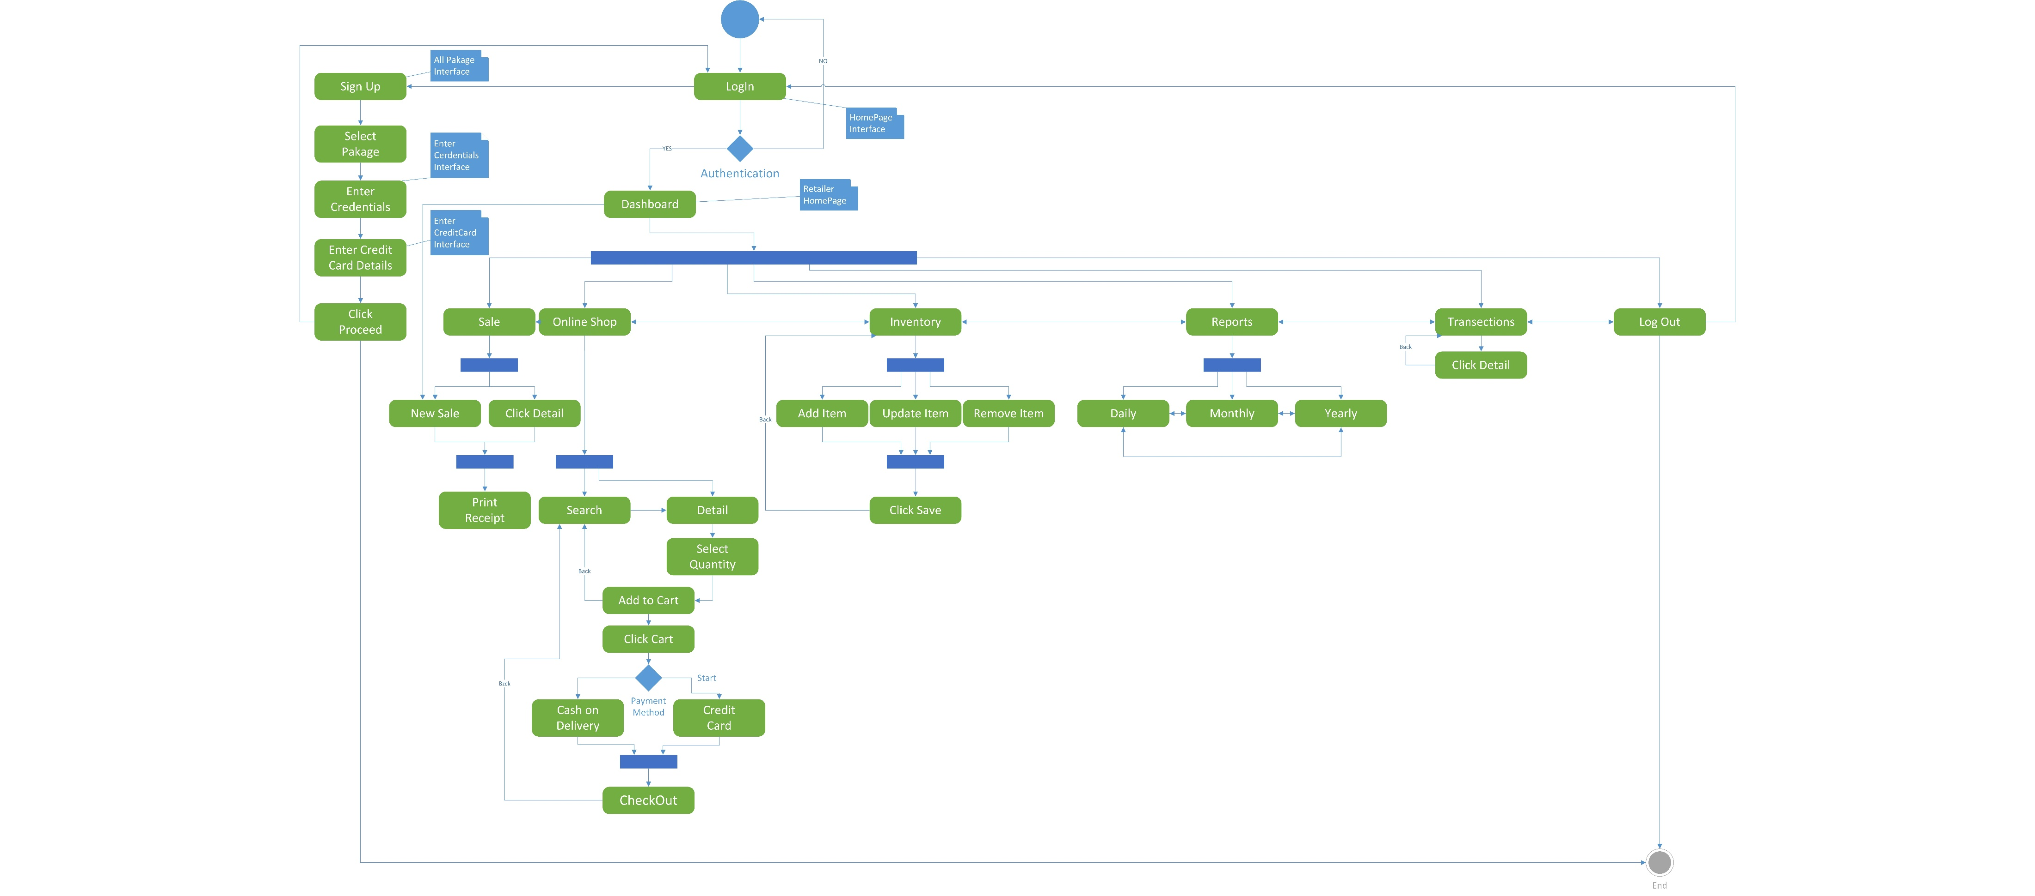
Activity/State Machine Diagram

Slide 18
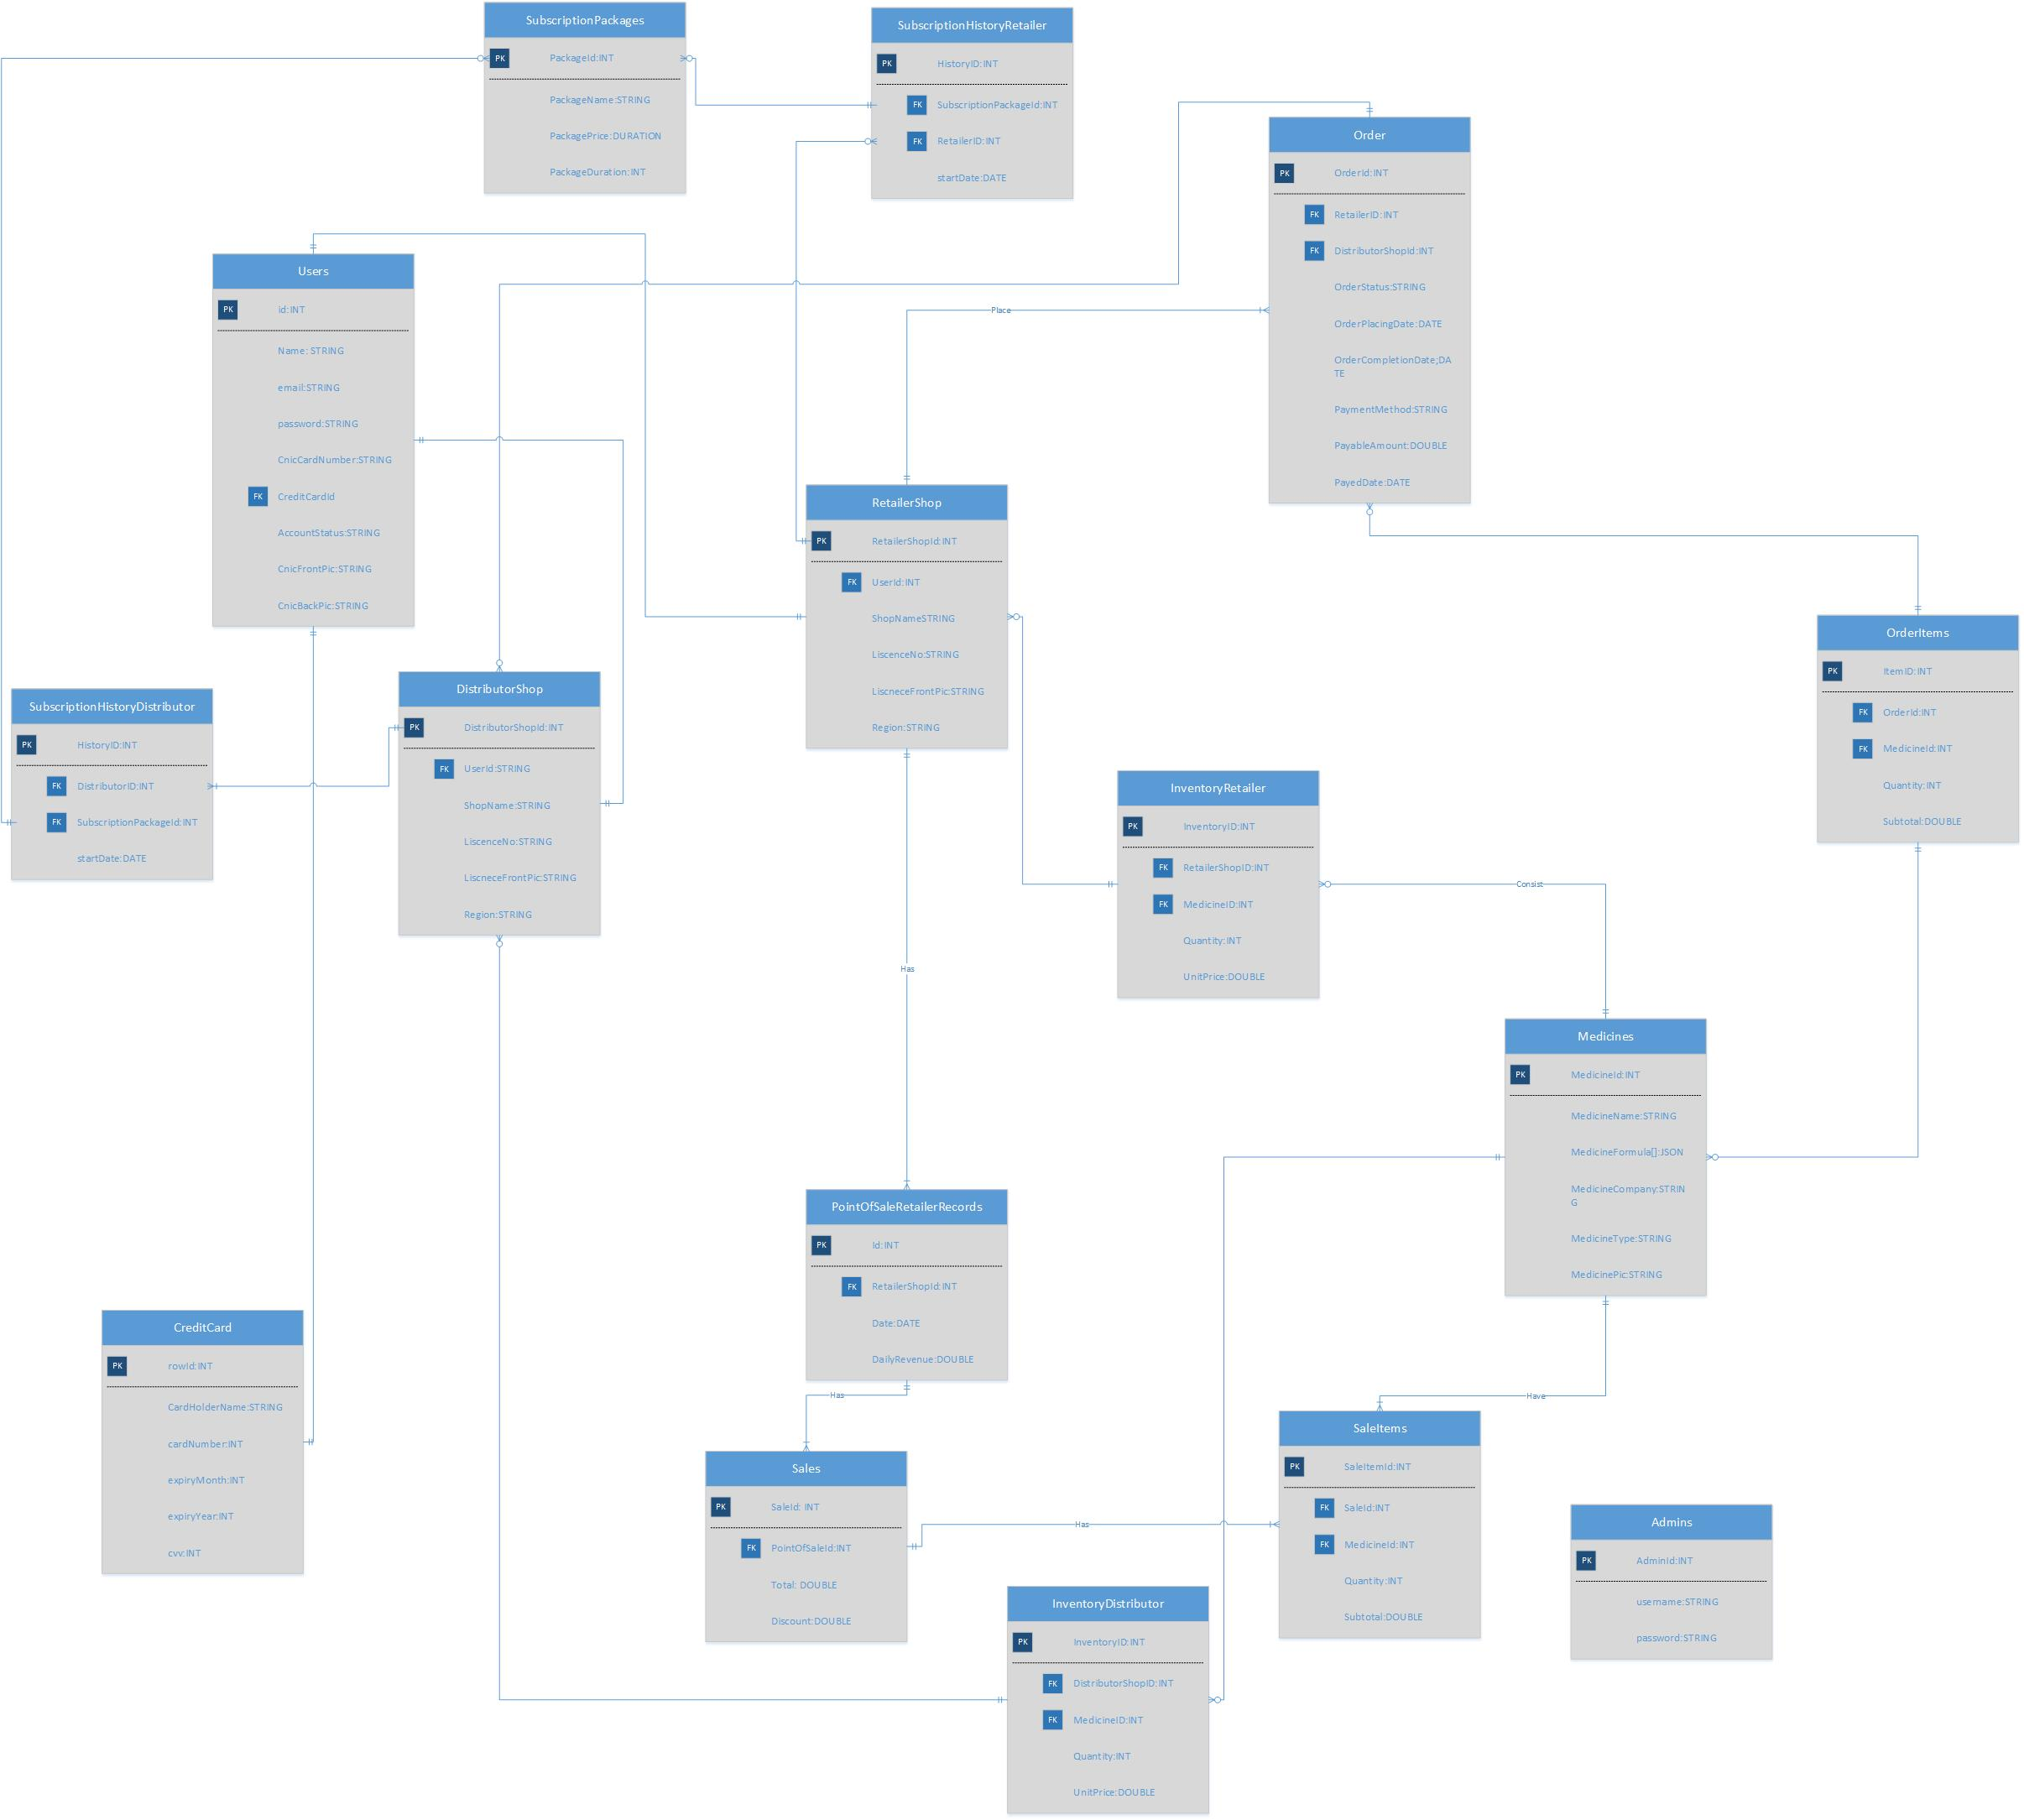
ER Diagram

Slide 19
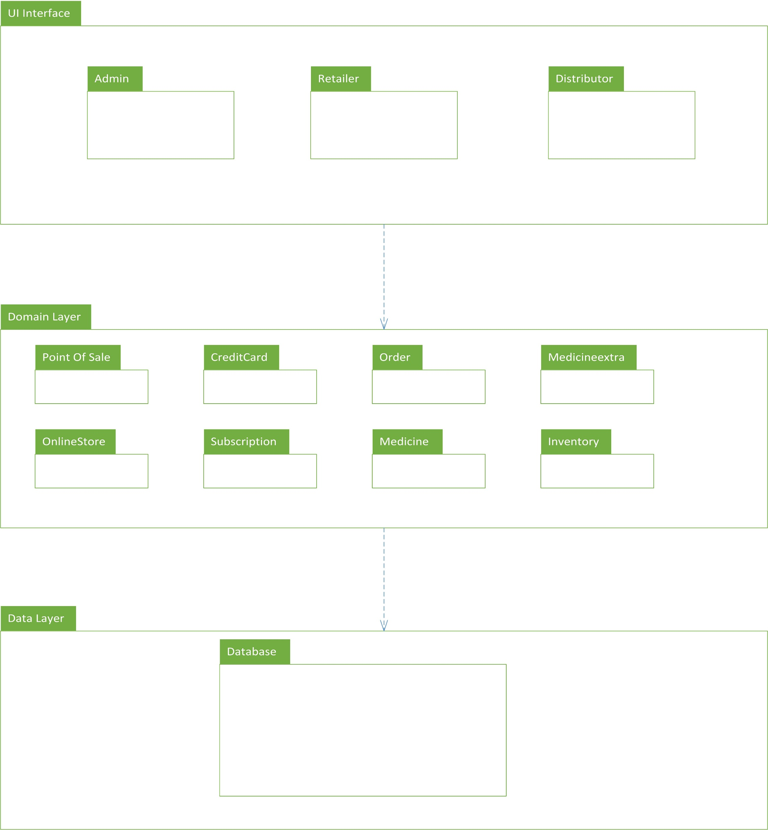
Package Diagram

Slide 20
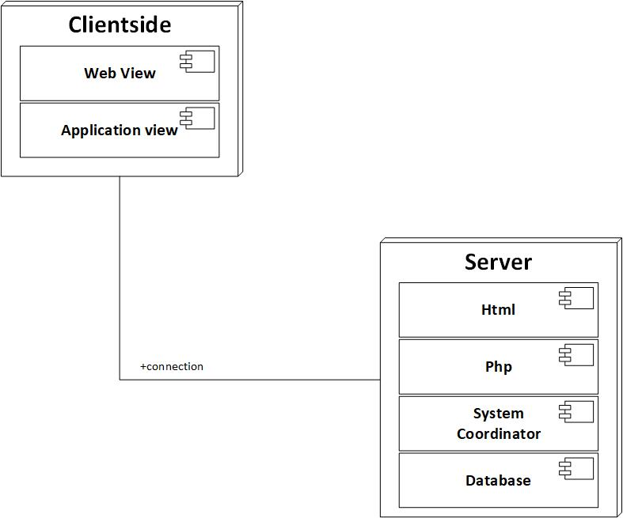
Deployment Diagram

Slide 21
Decision Table, Pseudocode

Slide 22
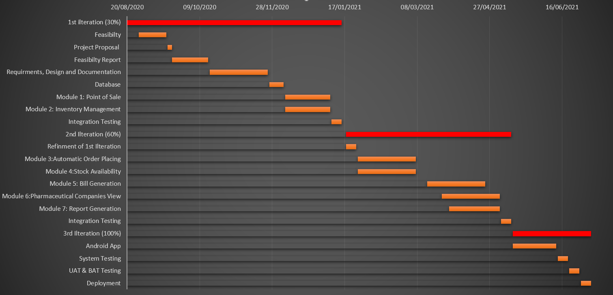
Schedule

Slide 23
Details of 1st Iteration (30%)
SRS
SDD
Database
Online Store

Slide 24
Details of 2nd Iteration (50%)
Point of sale
Inventory Management
Reports Generation

Slide 25
The End

